Slide 1

G R A P H

Slide 2
CONTENTS:
Introduction to Graph
Graph Terminologies
Representation of Graph
Graph Traversal

Slide 3
Introduction to Graph
A graph is a non-linear data structure, which contains a set of vertices (or nodes) and edges which connect themselves.
In case of Tree structure, there is a hierarchical relationship between parent and child node i.e One parent and many children.
On the other hand, in case of a graph, the relationship among the vertices is many parents to many children.

Slide 4
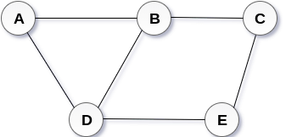
Introduction to Graph
Mathematically, A graph can be defined as : G = { V, E }
Where V = Set of Vertices and E = Set of Edges
E:g: In the above graph:
Here, V = { A,B,C,D,E}
E = { (A,B),(B,C),(A,D),(B,D),(D,E),(C,E) }

Slide 5
Graph Terminologies
Undirected Graph
Directed Graph
Weighted Graph
Adjacent Vertices
Self Loop
Parallel Edges
Cyclic Graph
Acyclic Graph
Isolated Vertex
Degree of Vertex
Pendant Vertex

Slide 6
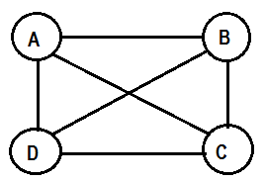
Undirected Graph
It is a graph such that G = { V,E} where V is set of vertices and E is the set of unordered pair of vertices.
Here,
V = { A,B,C,D}
E={(A,B),(B,C),(C,D),(A,D),(A,C),(B,D)}
Note: Unordered pair means same edge can be represented in any combination. For example, the edge (A,B) can be represented as (B,A).

Slide 7
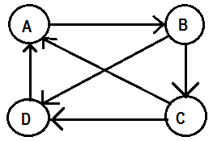
Directed Graph
It is a graph such that G = {V , E} where V is set of vertices and E is the set of ordered pair of vertices.
Here,
V = { A,B,C,D}
E={(A,B),(B,C),(C,D),(D,A),(C,A),(B,D)}
Note: If an ordered pair (A,B) is in set E, then there is an edge directed from A to B (indicated by arrow sign)

Slide 8
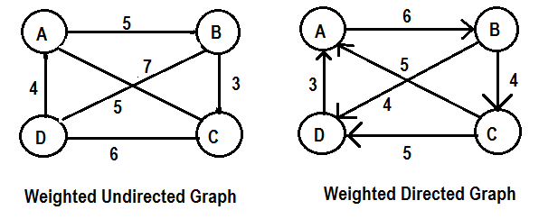
Weighted Graph
A graph is termed as weighted if all the edges are labeled with some weights. A weighted graph can be undirected or directed.

Slide 9
Adjacent Vertices
In case of directed graph, a vertex X is adjacent to Y, if there is an edge from X to Y.
Here, Vertex A is adjacent to Vertex B,
Vertex D is adjacent to Vertex A

Slide 10
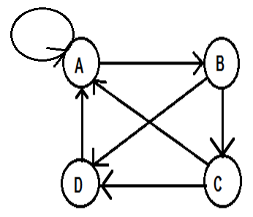
Self Loop
If there is an edge exist, where starting and end vertex are same i.e (A,A) is an edge, then it is called a self loop.
Here, there is a self loop at vertex A

Slide 11
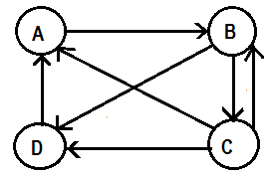
Parallel Edges
If there are more than one edge exist between the same pair of vertices, then they are known as parallel edges.
Here, parallel edge exist between Vertex B and Vertex C.

Slide 12
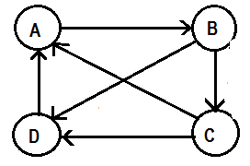
Cyclic & Acyclic Graph
Cycle: If there is path containing edges which start from vertex A and ends vertex A, then the path is called Cycle.
A graph which has one or more cycles is called Cyclic graph. Otherwise, it is called Acyclic graph.
Cyclic Graph
Here, three cycles exist.
The path is : (A,B),(B,C),(C,A)
(A,B),(B,D),(D,A)
(B,C),(C,D),(D,A),(A,B)

Slide 13
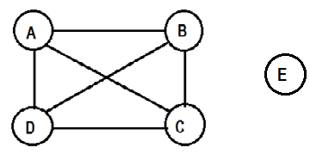
Isolated Vertex
A Vertex is isolated, if there is no edge connected from any other vertex to that vertex.
Here Vertex E is an isolated vertex as there is no edge connected to any other vertex of the graph.

Slide 14
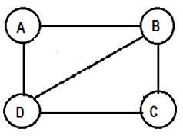
Degree of a Vertex ( Undirected Graph)
For undirected graph, the number of edges connected with a vertex X is degree of that vertex X.
Here, Degree(A) = 2, Degree(B) = 3
Degree(C) = 2, Degree(D) = 3

Slide 15
Degree of a Vertex ( Directed Graph)
For directed graph, there are two types of degrees. They are:
In-degree : In-degree of a vertex A is the number of edges incident into A(i.e. the number of edges ending at A)
Out-degree : Out-degree of vertex A is the number of edges eminating from A (i.e. number of edges beginning at A )

Slide 16
Degree of a Vertex ( Directed Graph)
In the above directed graph,
Indegree(A) = 2 Outdegree(A) = 1
Indegree(B) = 1 Outdegree(B) = 2
Indegree(C) = 1 Outdegree(C) = 2
Indegree(D) = 2 Outdegree(D) = 1

Slide 17
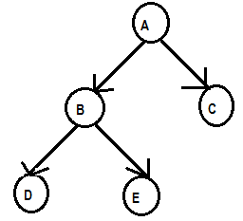
Pendant Vertex
A vertex X is called pendant if in-degree(X) is 1 and out-degree(X) is 0.
Here, Vertex C, D, E are pendant vertex

Slide 18
Representation of Graph
The graph can be represented using :
Sequential representation ( Using Matrix)
  Adjacency Matrix
  Incidence Matrix
2. Linked representation (Using Linked List)

Slide 19
Matrix Representation of Graph
Adjacency Matrix: For representing a graph “G” with “N” number of vertices, a matrix of NxN size can be considered.
Assume A[N][N] is matrix representing Adjacency matrix.
If “i” represents row position and “j” represents column position, then if there is an edge from V_{i} to V_{j} , Then A[i][j] = 1 else A[i][j] = 0 .

Slide 20
Adjacency Matrix: An Example
Represent the following graph in Adjacency Matrix.
 | A | B | C | D
A | 0 | 1 | 0 | 0
B | 0 | 0 | 1 | 1
C | 1 | 0 | 0 | 1
D | 1 | 0 | 0 | 0

Slide 21
Disadvantage of Adjacency Matrix
The Adjacency matrix has following disadvantages:
It requires n² space to represent a graph and also takes n² time solve most the graph related problems.
It may be difficult to insert and delete nodes, because the size of matrix need to be changed.

Slide 22
Matrix Representation of Graph
Incidence Matrix: An Incidence matrix consists of a row for every vertex and a column for every edge.
For representing a graph “G” with “N” number of vertices and “E” number of edges, a matrix of NxE size can be considered.
Assume A[N][E] is matrix representing Incidence matrix.
Here, if there is an edge E_{k} exist from V_{i} to V_{j} then V_{i}E_{k} = 1, V_{j}E_{k} = -1 and other at E_{k} = 0

Slide 23
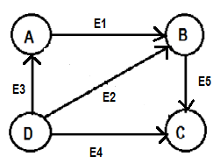
Incidence Matrix: An Example
Represent the following graph in Incidence Matrix.
 | E1 | E2 | E3 | E4 | E5
A | 1 | 0 | -1 | 0 | 0
B | -1 | -1 | 0 | 0 | 1
C | 0 | 0 | 0 | -1 | -1
D | 0 | 1 | 1 | 1 | 0

Slide 24
Linked Representation of Graph
In the linked representation, an adjacency list is used to store the Graph into the computer's memory.
The structure of node will be as follow:
VERTEX : It consists the name of the Vertex
NEXT : It is a pointer to next vertex
LIST : It points to 1st node of adjacency list
VERTEX | NEXT | LIST

Slide 25
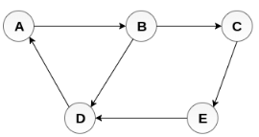
Linked Representation : An Example
Represent the following graph Using Linked List
VERTEX | ADJACENCY LIST
A | B
B | C,D
C | E
D | A
E | D

Slide 26
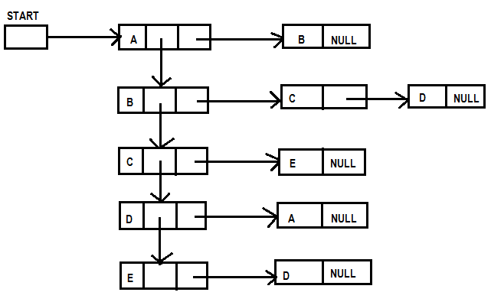
Linked Representation : An Example

Slide 27
Graph Traversal
A graph can be traversed in two standard ways. They are:
    Depth First Search (DFS)
    Breadth First Search (BFS)
In DFS, we will take the help of a Stack and in BFS, we will take the help of a Queue to hold the nodes for future processing.
During execution of above traversal algorithms, we consider three states for each vertex :
  Ready State : It is the initial state of each vertex
  Waiting State : When the vertex is within Stack or Queue
  Processed State : When the vertex is visited

Slide 28
Depth First Search (DFS)
Depth first search (DFS) algorithm starts with the initial node of the graph G, and then goes to deeper and deeper until we find the node which has no children.
The algorithm, then backtracks from the dead end towards the most recent node that is yet to be completely unexplored.
The data structure which is being used in DFS is stack.

Slide 29
Depth First Search (DFS) Algorithm
Step 1: SET STATUS = 1 (ready state) for each node in G
Step 2: Push the starting node A on the stack and set its STATUS = 2 (waiting state)
Step 3: Repeat Steps 4 and 5 until STACK is empty
Step 4: Pop the top node N. Process it and set its STATUS = 3 (processed state)
Step 5: Push on the stack all the neighbours of N that are in the ready state (whose STATUS = 1) and set their STATUS = 2 (waiting state)
[END OF LOOP – Step 3]
Step 6: EXIT

Slide 30
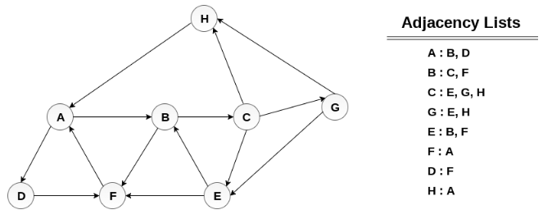
Depth First Search : An Example
Consider the graph G along with its adjacency list, given in the figure below. Calculate the order to print all the nodes of the graph starting from node H, by using depth first search (DFS) algorithm.

Slide 31
Depth First Search : An Example
Push H onto the stack
STACK : H
Pop the top element of the stack i.e. H, print it and push all the neighbours of H onto the stack that are is ready state.
Print H
STACK : A
Pop the top element of the stack i.e. A, print it and push all the neighbours of A onto the stack that are in ready state.
Print A
STACK: B, D
Pop the top element of the stack i.e. D, print it and push all the neighbours of D onto the stack that are in ready state.

Slide 32
Depth First Search : An Example
Print D
STACK : B, F
Pop the top element of the stack i.e. F, print it and push all the neighbours of F onto the stack that are in ready state.
Print F
STACK : B
Pop the top of the stack i.e. B and push all the neighbours
Print B
STACK : C
Pop the top of the stack i.e. C and push all the neighbours.

Slide 33
Depth First Search : An Example
Print C
STACK : E, G
Pop the top of the stack i.e. G and push all its neighbours.
Print G
STACK : E
Pop the top of the stack i.e. E and push all its neighbours.
Print E
STACK :
Hence, the stack now becomes empty and all the nodes of the graph have been traversed.
The printing sequence of the graph will be :
H → A → D → F → B → C → G → E

Slide 34
Breadth First Search (BFS)
Breadth first search is a graph traversal algorithm that starts traversing the graph from root node and explores all the neighbouring nodes.
Then, it selects the nearest node and explore all the unexplored nodes. The algorithm follows the same process for each of the nearest node until it finds the goal.
The data structure which is being used in DFS is queue.

Slide 35
Breadth First Search (BFS) Algorithm
Step 1: SET STATUS = 1 (ready state) for each node in G
Step 2: Insert the starting node A into queue and set its STATUS = 2 (waiting state)
Step 3: Repeat Steps 4 and 5 until QUEUE is empty
Step 4: Delete node N and Process it and set its STATUS = 3 (processed state).
Step 5: Delete all the neighbours of N that are in the ready state (whose STATUS = 1) and set their STATUS = 2 (waiting state)
[END OF LOOP]
Step 6: EXIT

Slide 36
Breadth First Search : An Example
Consider the following graph G shown below , calculate the minimum path p from node A to node E. Given that each edge has a length of 1.

Slide 37
Breadth First Search : An Example
Minimum Path P can be found by applying breadth first search algorithm that will begin at node A and will end at E.
The algorithm uses a QUEUE which holds all the nodes that are to be processed.
Lets start examining the graph from Node A.
1. Add A to QUEUE.
QUEUE = {A}
2. Delete the Node A from QUEUE and insert all its neighbours. Process the node A.
QUEUE = {B, D}
PRINT = {A}

Slide 38
Breadth First Search : An Example
3. Delete the node B from QUEUE and insert all its neighbours. Process node B.
QUEUE = {D, C, F}
PRINT = {A, B}
4. Delete the node D from QUEUE and insert all its neighbours. Since F is the only neighbour of it which has been inserted, we will not insert it again. Process node D.
QUEUE1 = {C, F}
PRINT = { A, B, D}
5. Delete the node C from QUEUE1 and insert all its neighbours. Process node C.
QUEUE = {F, E, G}
PRINT = {A, B, D, C}

Slide 39
Breadth First Search : An Example
6. Remove F from QUEUE and add all its neighbours. Since all of its neighbours has already been added, we will not add them again. Process node F.
QUEUE = {E, G}
PRINT = {A, B, D, C, F}
7. Remove E from QUEUE, all of E's neighbours has already been added to QUEUE, therefore we will not add them again. All the nodes are visited and the target node i.e. E is encountered.
QUEUE = {G}
PRINT = {A, B, D, C, F, E}
The minimum path will be A → B → C → E.

Slide 40
Thank You

